Slide 1


The Apple Inc
The Apple Inc
Project made by
Butnariu Diana-Cristina
and
Busnatu Flavia-Paula
Group 222

Slide 2
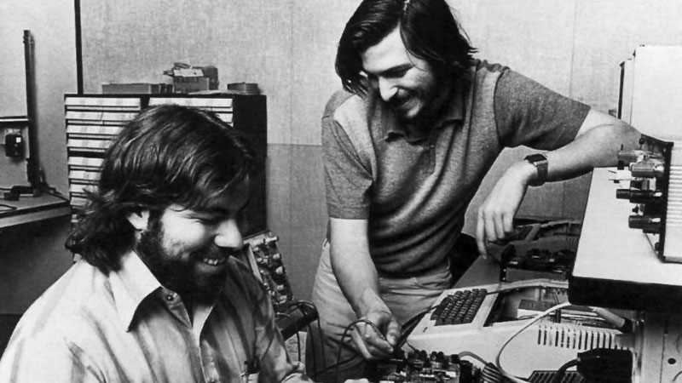
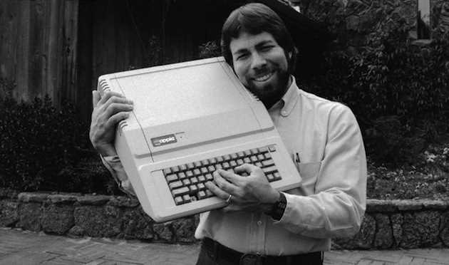
The Apple Inc
History
Founding (1976)
Apple Inc. was founded by Steve Jobs, Steve Wozniak, and Ronald Wayne, with the release of the Apple I computer.
The Apple II (1977)
The Apple II was introduced, becoming one of the first commercially successful personal computers, driving Apple's early success.

Slide 3
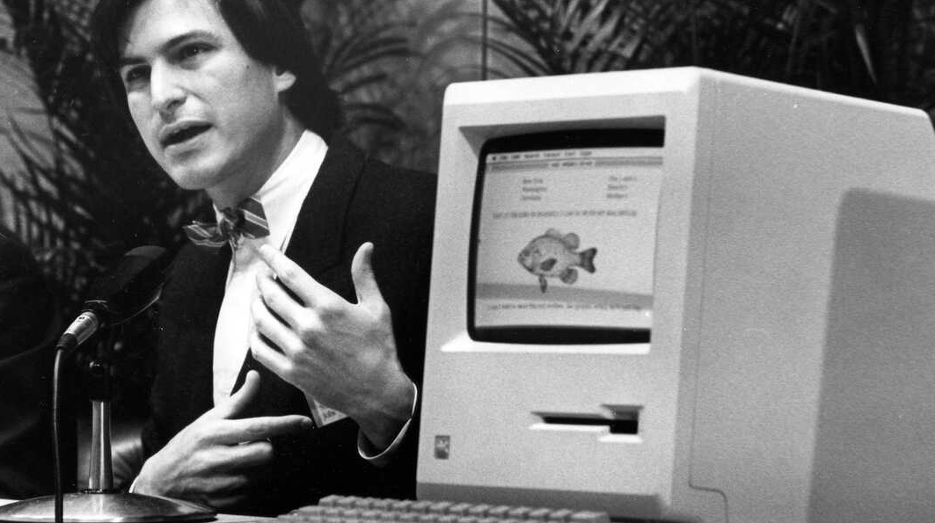

The Apple Inc
History
Macintosh (1984)
The Macintosh, with its graphical user interface, redefined personal computing, making it accessible and user-friendly.
Turbulent Times (1985-1996)
Internal conflicts and declining sales led to Jobs leaving Apple, followed by several leadership changes.

Slide 4
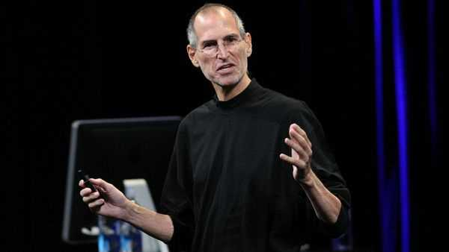
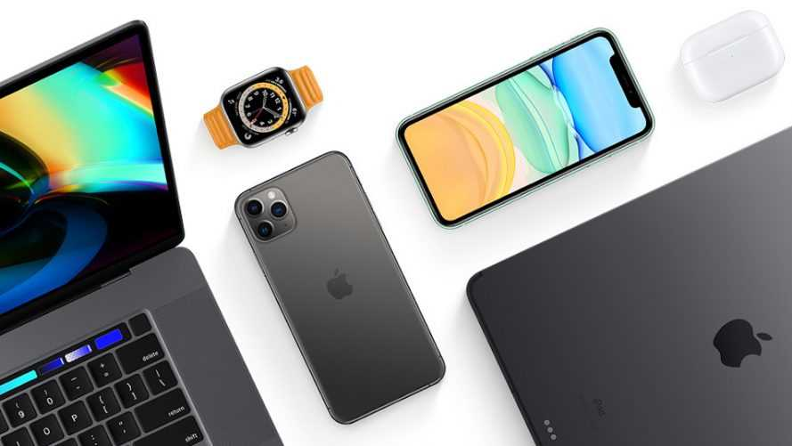
The Apple Inc
History
Return of Steve Jobs (1997)
Steve Jobs returned as CEO, leading Apple's resurgence with iconic products like the iMac, iPod, iPhone, and iPad.
Modern Innovations (2000s-present)
Apple continued its innovation, expanding its ecosystem with iOS devices, services, and the App Store, solidifying its position as a global tech leader.

Slide 5
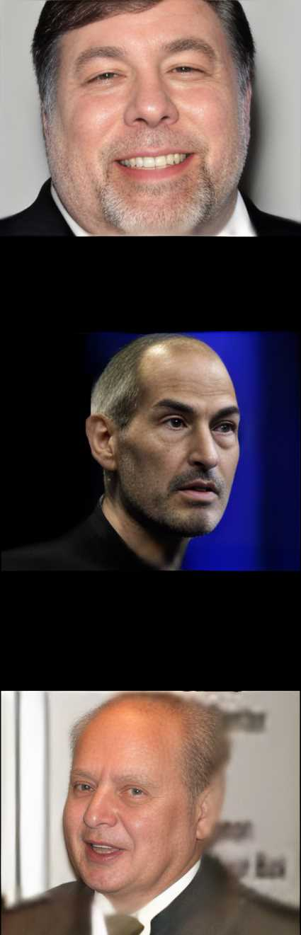
The Apple Inc
Founding of Apple Inc.
Apple Inc. is a leading American technology company founded in 1976 by Steve Jobs, Steve Wozniak, and Ronald Wayne. It is renowned for its innovative products such as the iPhone, iPad, and Mac, as well as its software and services like iOS, macOS, and the App Store. With its relentless focus on design, user experience, and seamless integration, Apple has become one of the most valuable and influential companies in the business world. Its impact on consumer electronics, software development, and the overall tech industry has been transformative, setting new standards and inspiring competitors to strive for excellence.

Slide 6
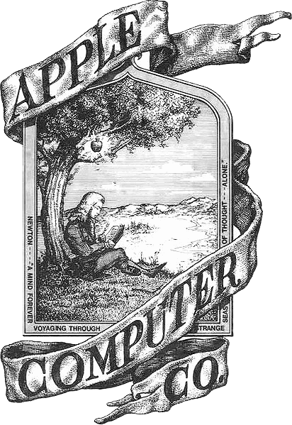


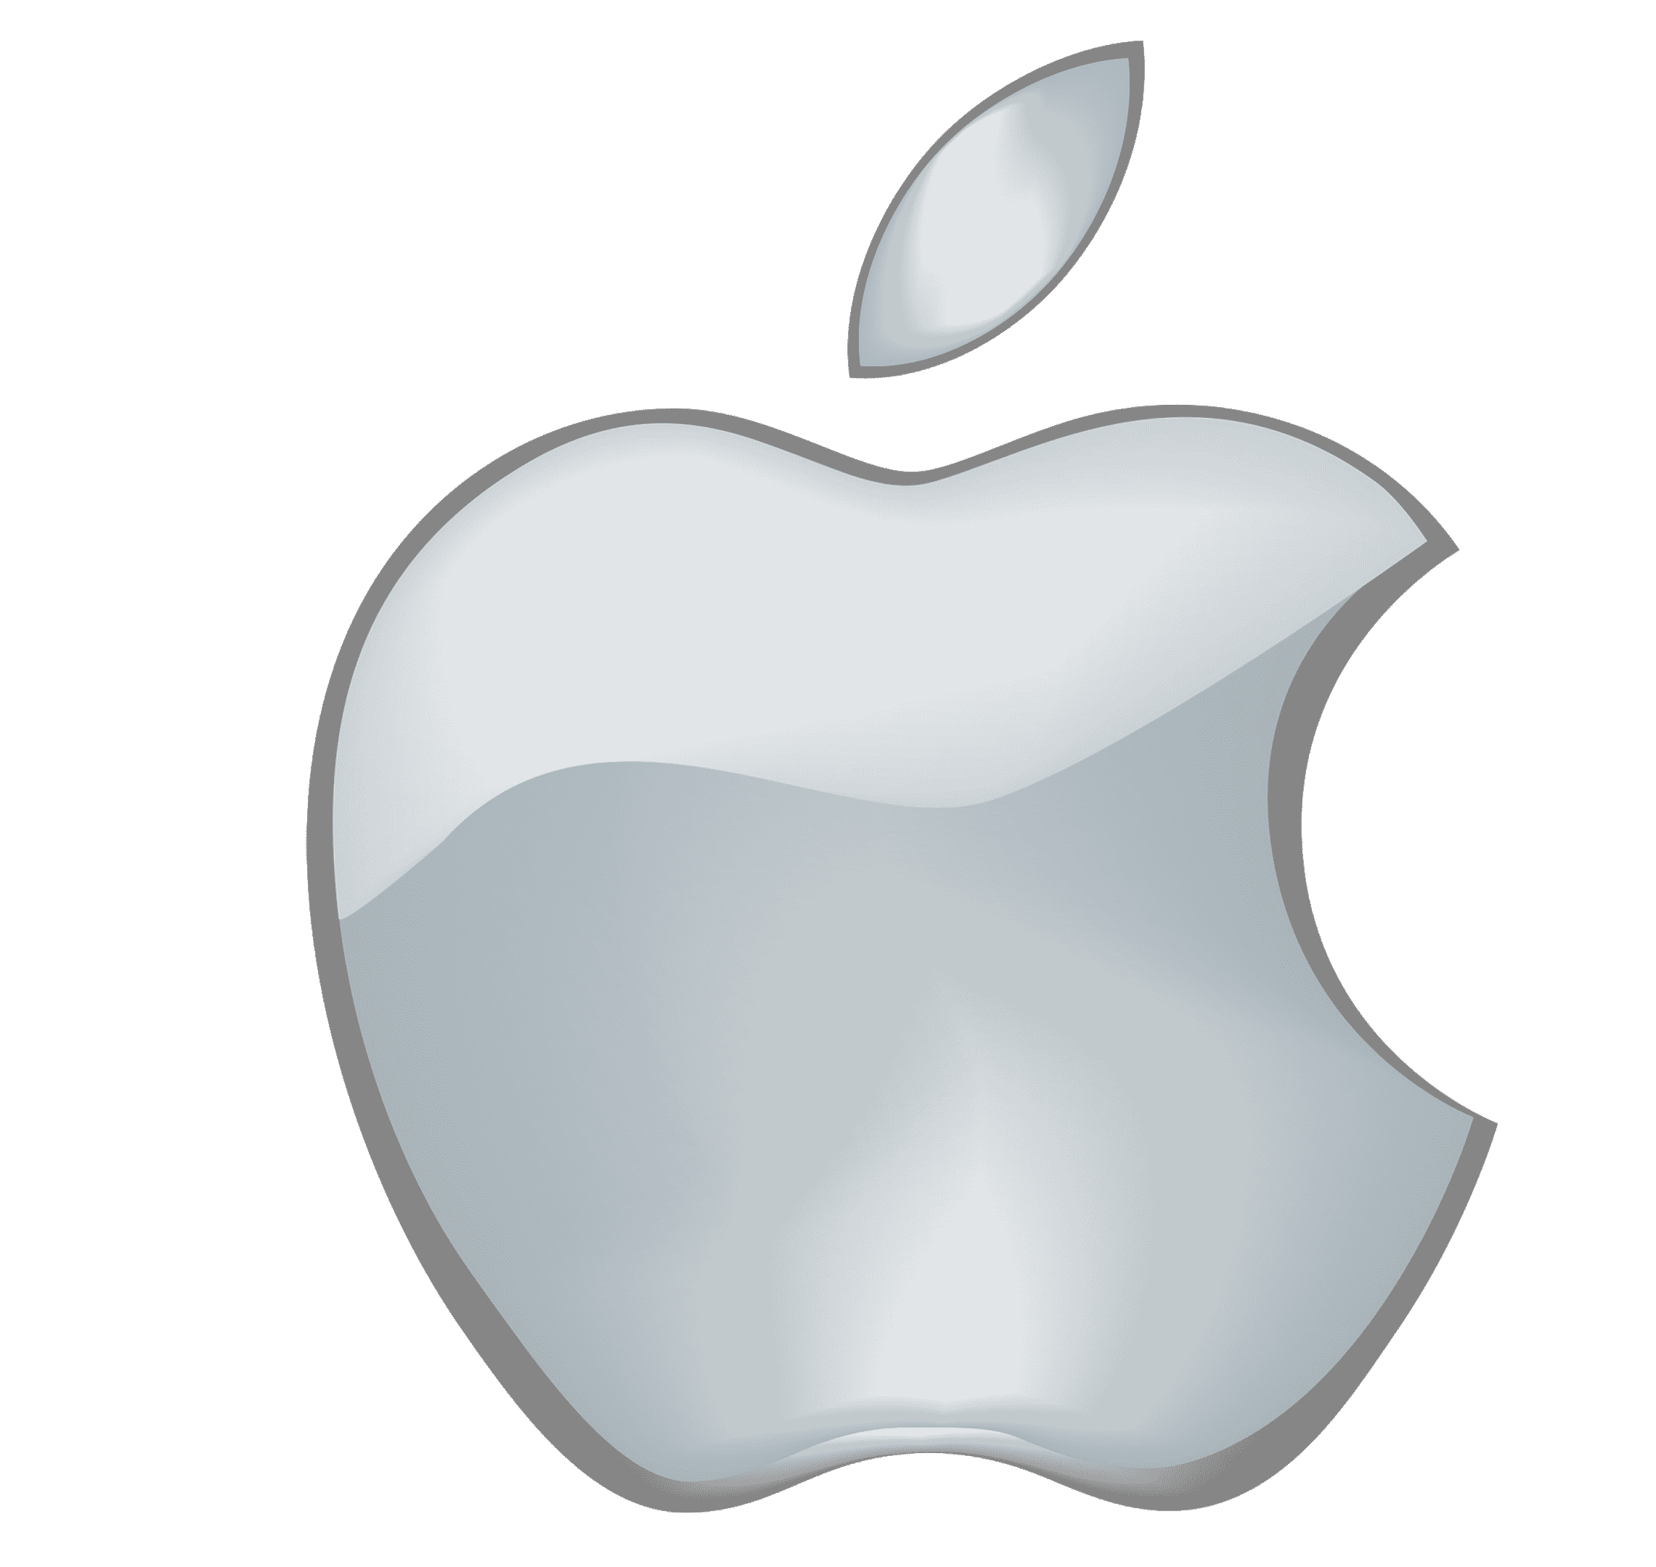

The Apple Inc
Apple Logo History
1976
1998
2007
1977
2001
Current

Slide 7
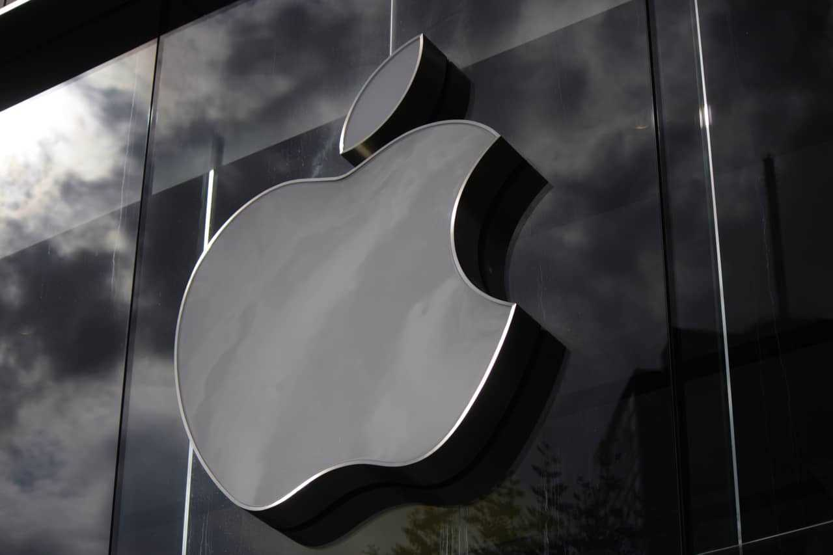
The Apple Inc
Branding And Marketing Strategies
Branding Strategy: Create a unique, emotional brand identity that reflects innovation, quality, and lifestyle to differentiate from competitors.
Marketing Strategy: Employ emotional storytelling, iconic product launches, and social media engagement to build a devoted customer base and drive sales.

Slide 8
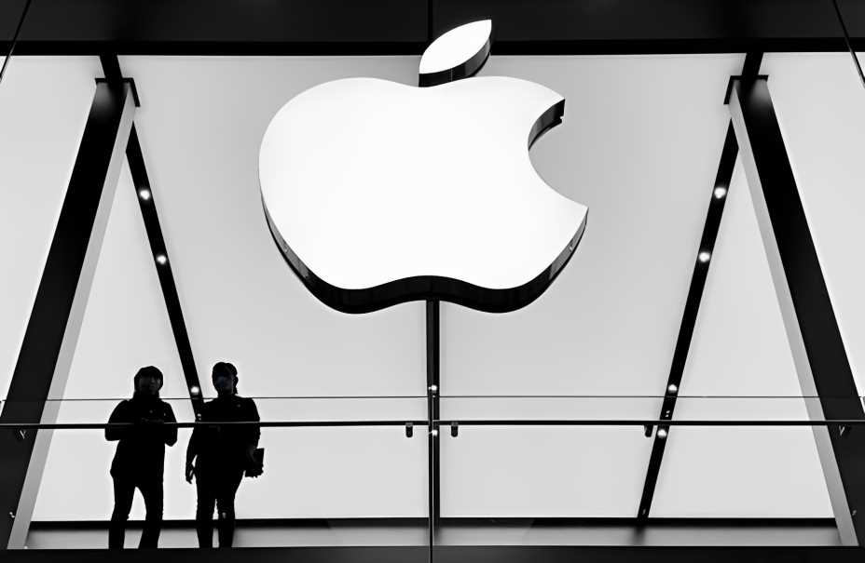
The Apple Inc
Vision and Mission
Mission
Vision
“The Company is committed to bringing the best personal computing, portable digital music and mobile communication experience to students, educators, creative professionals, businesses, government agencies, and consumers through its innovative hardware, software, peripherals, services, and Internet offerings.”
“Man is the creator of change in this world.
As such he should be above systems and
structures, and not subordinate to them."

Slide 9
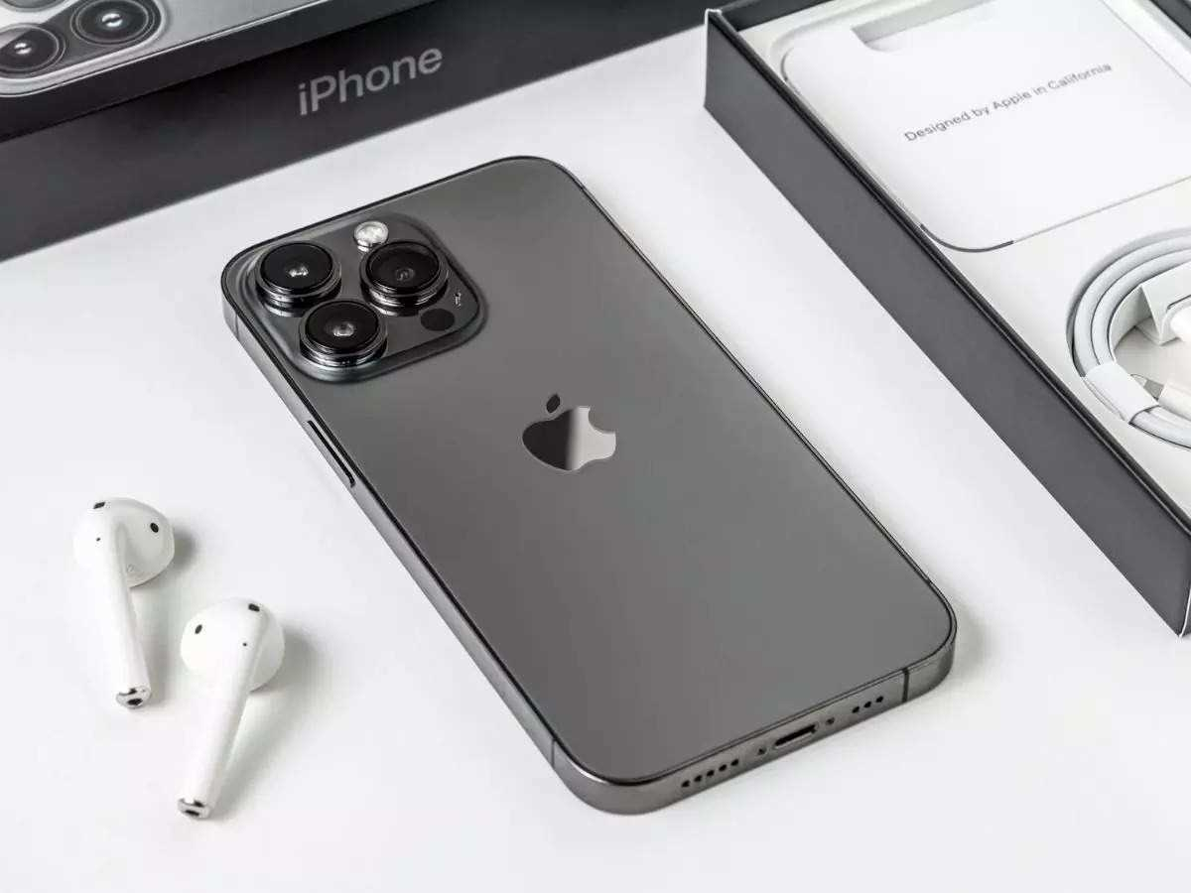
The Apple Inc
Why are they successful
The reason that apple is so successful is because when they invent or update one of their products, they make it while considering the wants of their customers
->Another reason is that the products that they produce might cost a little much but are very high quality and can do many, many things ->The last reason is that they don’t make an item and leave it, every year or so, they try to find some way to improve or update it

Slide 10
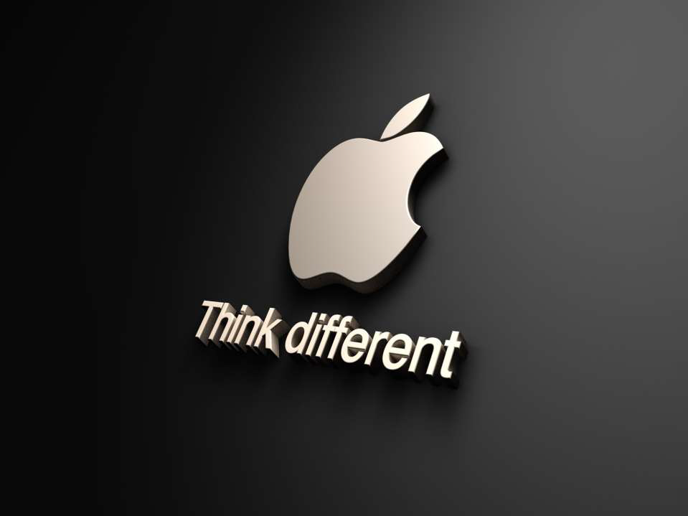
The Apple Inc
Conclusion
For 35 years, Apple has been a trend-setter company able to foresee the future. Because their strength is the innovation and they know how to „think different‟.

Slide 11

The Apple Inc
Thank You

